Slide 1
Mining incentives and strategies

Slide 2
Analysis of mining
Several strategic decisions
Which transactions to include in a block
Default: any above minimum transaction fee
Which block to mine on top of
Default: longest valid chain
How to choose between colliding blocks
Default: first block heard
When to announce new found blocks
Default: immediately after finding them

Slide 3
Forking:
Regular/Temporary Fork / Accidental Fork
Soft fork
Hard fork

Slide 4
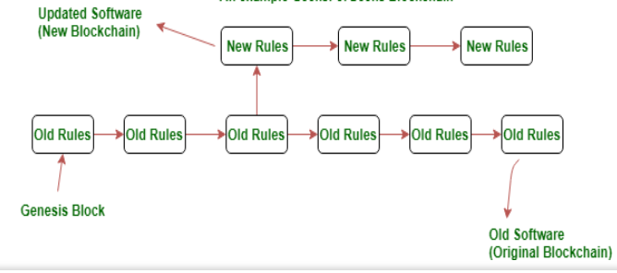

Slide 5
Soft fork
Example: The Bitcoin network’s SegWit update added a new class of addresses (Bech32). However, this didn’t invalidate the existing P2SH addresses. A full node with a P2SH type address could do a valid transaction with a node of Bech32 type address.
Hard fork
Example:
The new Casper update in the Ethereum Blockchain in which the consensus protocol will change from a type of Proof of Work (PoW) to a type of Proof of Stake (PoS). The nodes which install the Casper update will use the new consensus protocol. Full nodes that do not choose to install the Casper update will become incompatible with the full nodes that do.
Regular
Example:
Temporary forks happen more often than not and a usual event that triggers this fork is mining of a block by more than one party at nearly the same time.

Slide 6
Why do forks occur?
Blockchains are updated for a variety of reasons:
To add functionality
To address security risks
To resolve a disagreement within the community about the cryptocurrency’s direction

Slide 7
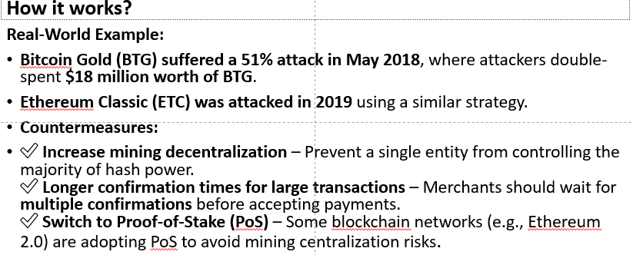
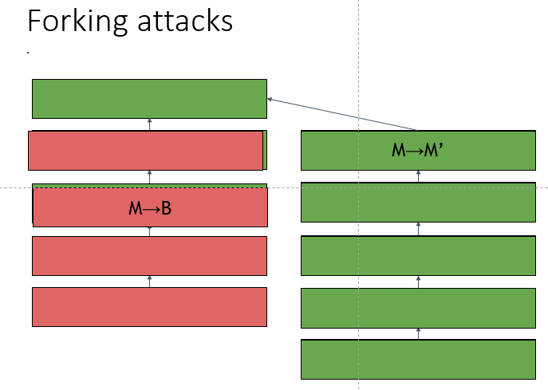
Attacks in Bitcoin Mining

Slide 8
2.Forking attacks via bribery(Bribery attack/Nothing-at-Stake)
How It Works:
Why Bribery Attacks Are Dangerous:
Attackers don’t need to buy mining hardware; they simply pay existing miners.
It’s cheaper than a 51% attack, making it more feasible.
If many miners accept bribes, the blockchain's security is severely weakened.
Countermeasures:
✅ Implement strong network monitoring – Detect unusual mining activity. ✅ Economic incentives for honest mining – Ensure legitimate mining is more profitable than attacking the network. ✅ Penalties for dishonest miners – Blockchain protocols could introduce mechanisms that penalize miners for suspicious activities.

Slide 9
3.Block-withholding attacks(Selfish Mining ):
Strategy: don’t announce blocks right away. Try to get ahead!
“Selfish mining”
Why would it be possible to gain in mantaining some block secret?
Secret Block
Secret Block
All other miners are wasting effort here!

Slide 10
Strategy: don’t announce blocks right away. Try to get ahead!
-- This attack can undermine the trust and stability of the blockchain system
How a Block Withholding Attack Works:
--Mining a Valid Block: A malicious miner (or pool member) mines a valid block but does not immediately broadcast it to the blockchain network.
--Withholding the Block: Instead of broadcasting the valid block, the miner keeps it hidden. This prevents the block from being added to the blockchain, and other miners continue to work on the previous block.

Slide 11
Purpose:
-Sabotage: In a mining pool, a dishonest miner may attempt to sabotage the pool by withholding blocks, reducing the overall earnings of the pool.
--Self-Gain: In some scenarios, the attacker could attempt to create a situation where their hidden block could later be revealed at an opportune moment, allowing them to overtake the current chain (creating a fork or reorganization).

Slide 12
Consequences of a Block Withholding Attack:
-- Wasted Resources: Honest miners waste computational power working on an outdated chain.
-- Reduced Pool Efficiency: In the case of a pool, the overall efficiency of the pool is reduced, as fewer valid blocks are found and broadcast to the network.
--- Centralization Risk: Prolonged or large-scale attacks can lead to centralization, as smaller or vulnerable pools may be forced to merge with larger ones.
--- Network Instability: If block withholding is used in combination with other attacks, such as selfish mining, it could lead to network instability, chain reorganization, and even temporary forks in the blockchain.

Slide 13
4. Punitive Forking (Blacklisting Transactions)
How It Works:
A group of miners decides to blacklist certain transactions (e.g., transactions linked to criminal activity or politically motivated addresses).
They refuse to mine any block containing the blacklisted transactions.
If large mining pools coordinate, they can force censorship on the network.
Users with blacklisted transactions face delays or permanent exclusion from the network.
Why It’s Problematic:
Leads to blockchain censorship – Certain users may be unfairly excluded.
Gives miners too much power – They can choose which transactions get confirmed.
Encourages government interference – Regulatory authorities may pressure miners to block specific addresses.
Countermeasures:
✅ Promote mining decentralization – The more independent miners there are, the harder it is to coordinate blacklisting. ✅ Use privacy-enhancing tools – Techniques like CoinJoin (used in Bitcoin mixing) can obscure transaction histories. ✅ Implement slashing penalties – Miners who engage in transaction censorship could be penalized.

Slide 14
5. Feather-Forking Attack
How It Works:
Attackers announce that they will fork the blockchain if certain transactions are included.
They mine an alternative chain for a short period to create uncertainty.
If honest miners choose to include blacklisted transactions, the attackers start mining their own chain.
Eventually, the attackers stop mining on their fork because maintaining it is costly.
Honest miners, fearing future forks, voluntarily stop including blacklisted transactions to avoid disruptions.
Why It’s Dangerous:
Creates uncertainty – Users may fear their transactions will be invalidated.
Discourages legitimate transactions – Users avoid transactions that might trigger a feather-fork.
Can be used for economic coercion – Attackers could pressure exchanges or businesses to block certain users.
Countermeasures:
✅ Incentivize honest mining – Make mining on the main chain more profitable. ✅ Use economic penalties – Punish miners who engage in feather-forking attempts. ✅ Increase miner anonymity – If attackers can’t coordinate, feather-forking becomes impractical.

Slide 15
Summary Table of Attack Attack | Impact | Countermeasures
Forking Attack (Double Spending) | Allows reversing transactions | Increase decentralization, longer confirmation times
Bribery Attack | Attackers manipulate miners | Network monitoring, penalties for dishonest mining
Selfish Mining | Wastes competitor hash power | Fast block propagation, decentralization
Punitive Forking | Censorship of transactions | Privacy-enhancing tools, miner decentralization
Feather-Forking | Pressures miners to reject transactions | Economic penalties, miner anonymity
To keep Bitcoin secure, developers and miners must work together to prevent these vulnerabilities.

Slide 16
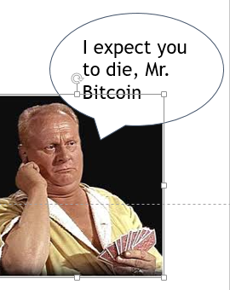
Goldfinger Attack:
step-by-step of the Goldfinger attack on Bitcoin
Step 1: Acquire majority of mining hardware
-An attacker buys or controls a large majority of the specialized computer chips (ASIC miners) used for mining Bitcoin.
- This gives them control over a significant portion of the network's mining power.
Step 2: Control the network
- With their majority of mining hardware, the attacker can control the network's mining power.
- They can decide which transactions to include in the blockchain and which to exclude.

Slide 17
Step 3: Manipulate transactions
- The attacker can use their control to: - Double-spend coins (spend the same coins twice)
- Block or delay transactions - Steal mining rewards
Step 4: Disrupt the network
- The attacker's manipulation can disrupt the entire Bitcoin network.
- This can lead to a loss of trust in the network and potentially even a collapse of the currency.

Slide 18
Why it is s unlikely:
- Requires an enormous amount of resources to acquire and maintain control over the majority of mining hardware.
- The decentralized nature of the Bitcoin network makes it hard for one person to control.
- The community is working to prevent such an attack through decentralizing mining pools and developing more energy-efficient mining hardware.

Slide 19
Mitigation Strategies:
-- Detection Mechanisms: Mining pools can develop algorithms to detect and discourage block withholding by analyzing miner behavior.
-- Protocol Adjustments: Blockchain protocols could be adjusted to reduce the incentive for withholding valid blocks or to penalize malicious miners who attempt to withhold blocks.

Slide 20
transaction fees
Default policy:
priority = sum(input_value * input_age)/size_in_bytes
the transactions with higer values, that are spending older coins that haven't been moved in a while and with smaller dimensions have higer priority.
So, if you want to move money more quickly, with lower amounts and complicated scripts, you will have to pay higher fees.
Miners Accept without fees if:
priority > 0.576
It's a very arbitrary choice, but it's the default of Bitcoin core client.

Slide 21
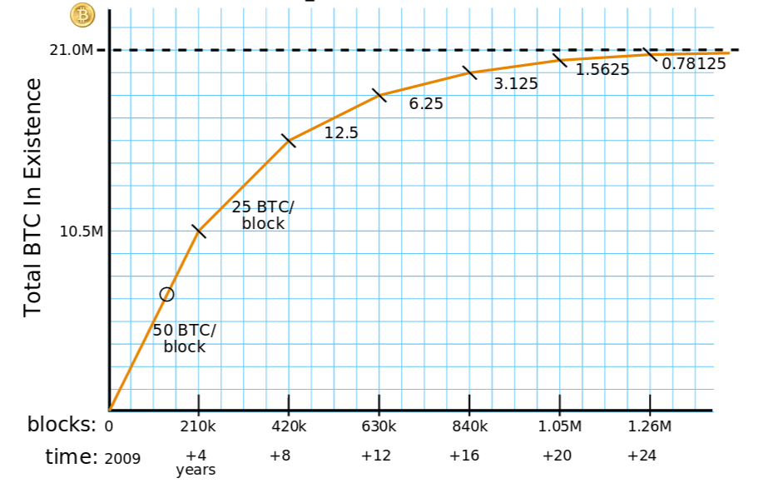
Transaction fees will matter more
Key Observations:
Declining Block Rewards:
The most recent halving occurred in April 2024, reducing the block reward from 6.25 BTC to 3.125 BTC per block.
This reduction aligns with Bitcoin's programmed halving schedule, which decreases miner rewards by 50% approximately every four years.
2. Transaction Fees as a Growing Revenue Source:
With the decrease in block rewards, transaction fees have become an increasingly vital component of miner revenue.
During periods of high network activity, such as the lead-up to the 2024 halving, transaction fees spiked, contributing significantly to miners' earnings.
3. Total Miner Revenue Trends:
Despite the reduction in block rewards, total miner revenue has experienced fluctuations influenced by Bitcoin's market price and transaction volume.
As of February 25, 2025, daily miner revenue stands at approximately $42.86 million, reflecting a 7% increase from the previous day but a 7.79% decrease compared to the same period last year
Courtesy: Brian Warner

Slide 22
As of 2025, over 19.6 million BTC have been mined.
By 2140, nearly all 21 million BTC will have been issued.
After that point, miners will rely entirely on transaction fees.In the future, transaction fees will be the primary income for miners.
As of 2025, the current block reward is 3.125 BTC per block. -- The next halving (expected in 2028) will reduce it to 1.5625 BTC. --Transaction fees currently account for ~10-15% of total miner revenue (up from <1% in early years).
Open questions:
Will miners collude to enforce higher fees?
Will they refuse low-fee transactions?

